Slide 1
EdTOA Video Conferencing Smorgasbord
SUNY Broome community college
  Fermin Romero III

Slide 2
Today we’ll cover
Problems we faced
  What led us to even need a more than one solution
  Solutions we explored
  Both software and hardware
    Everyone has heard of at least one piece of hardware and at least one company providing video solutions.
Solutions that worked
    We tried a few. Which was right for us?
Landing on FUZE

Slide 3
Problems We Faced
Problem 1
Requests for video conferencing has gone up substantially in the past two years
  Most importantly – Board of Trustee Meetings required remote video conferencing during the winter months.
    We needed a Stable, Supportable, Sustainable and Scaleable solution.
Getting users to “buy in”

Slide 4
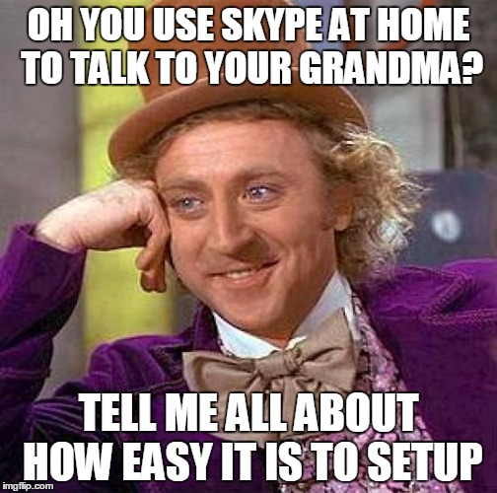
Problems We Faced
Problem 2
Users have a certain idea of what multi point video conferencing should look like
“It’s easy at home, so it should be easy at work
right?”
“This can’t be that hard”
“I can call the same day I want it setup right?”

Slide 5
Problems We Faced
Problem 3
How/Where do we set this up?
  SKYPE rooms
    Special SKYPE rooms go largely unused
    Although it seemed easier, support was harder
    Support, Space and Supplies are unlimited limited

Slide 6
Solutions that worked
We explored other options
GoToMeeting
Skype
BlueJeans
Fuze [formerly thinking box]
Polycom (desktop real presence)
Polycom (Group 700 series)
Collaborate
Google Hangouts
A Few Others
  There’s hundreds now, right?

Slide 7
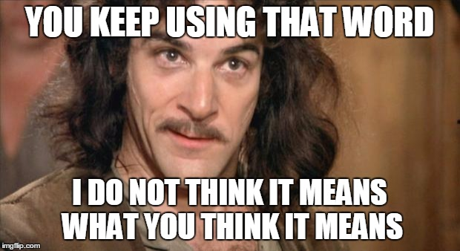
Solutions that worked
Skype
The eponym for all video conferencing
  Everyone’s heard of it
  Most everyone has/had an account
  It’s pretty easy to figure out
No one knows their username.
  No One
  Requires some logistics
  Because people think they know how it works they don’t test
Still a great solution for classroom video conferencing
  “Hey, can I do a Skype in my classroom?”
    Yes. I’ll set it up.

Slide 8
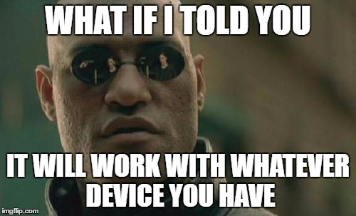
Landing on FUZE
“system agnostic”
  Telepresence Connect
  I have gotten the Polycom bridging to work once but it’s not as easy as I had hoped. It’s also an extra cost per year.
FTE Based Plans
  We have not implemented this but I like the idea
Elegant Interface
Allows Appointed host
  This is a bit of a “cheat” to hosting a meeting
  Probably why they changed the minimum number of licenses

Slide 9
Landing on FUZE
Maximum number of participants
  250 participants
    We only have 125 enabled(legacy plan)
  12 HD video participants

Slide 10
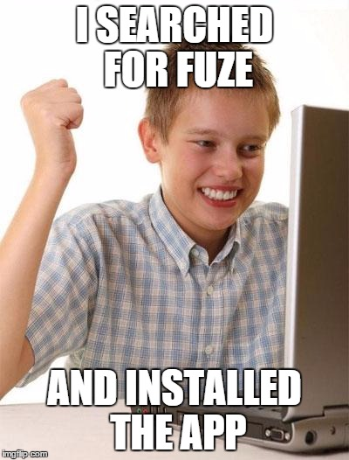
Landing on FUZE
Ease of joining with/without an existing account
  Super short instructions on how to join
  You will be video interviewing with us on Friday 1/15/2016 - 10:00 AM - 11:30 AM. The video software we use here on campus is called FUZE. With this software you can use a laptop, PC, Tablet or Phone.
  Please visit this site and download the version which matches your hardware: https://www.fuze.com/download
  You do not need to create an account. Just press the "JOIN MEETING" button.
  Enter meeting: 316-74-038

Slide 11

Landing on FUZE
Content sharing
  Text files – Word, etc
  PPTX
  Video
  Audio

Slide 12
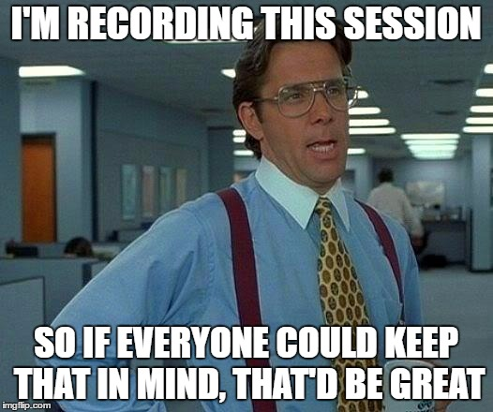
Landing on FUZE
Recording
  Recorded content can be downloaded or provided using a persistent link.
  If downloaded the downloaded file is an H.264 compressed MP4

Slide 13
Landing on FUZE
On going support
  What we are doing campus wide to make sure we are:
    Supportable
    Sustainable
    Scaleable
Cost
  Minimum of 40-50 licenses
  $40 per license/room (flexible – call to find out)
  BCC has a sweetheart deal
Future development
    What are we looking at next?

Slide 14
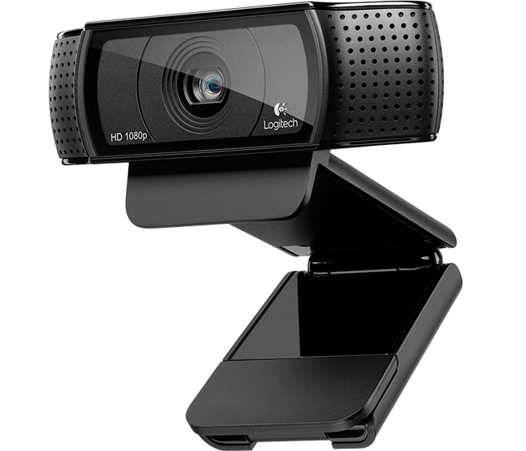
Hardware Solutions we explored
Webcams by Price
  Low
    Logitech Webcam C920
      This is our current top choice for desktop setups
      Previously we used the C930e
    LifeCam HD-5000

Slide 15
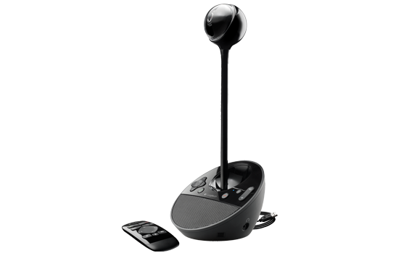
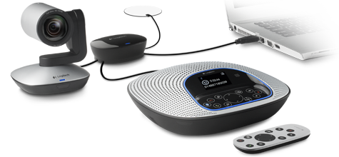
Hardware Solutions we explored
Webcams by Price
  Mid
    Logitech ConferenceCam BCC950
    Logitech ConferenceCam CC3000e
      This is our current top choice for classroom setups

Slide 16
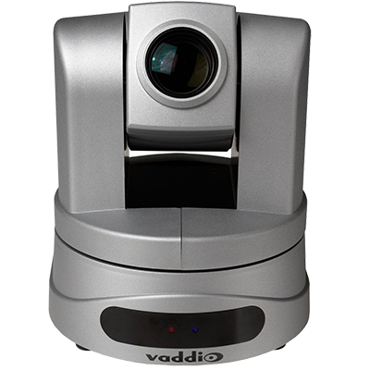
Hardware Solutions we explored
Webcams by Price
  High
    Vaddio RoboSHOT - https://www.youtube.com/watch?v=S8IsUwSX5Bk
      http://bit.ly/1JKgEfH
    Vaddio ClearVIEW HD-USB
      This is our current top choice for conference room setups
    Vaddio BaseSTATION
    Vaddio GroupSTATION

Slide 17
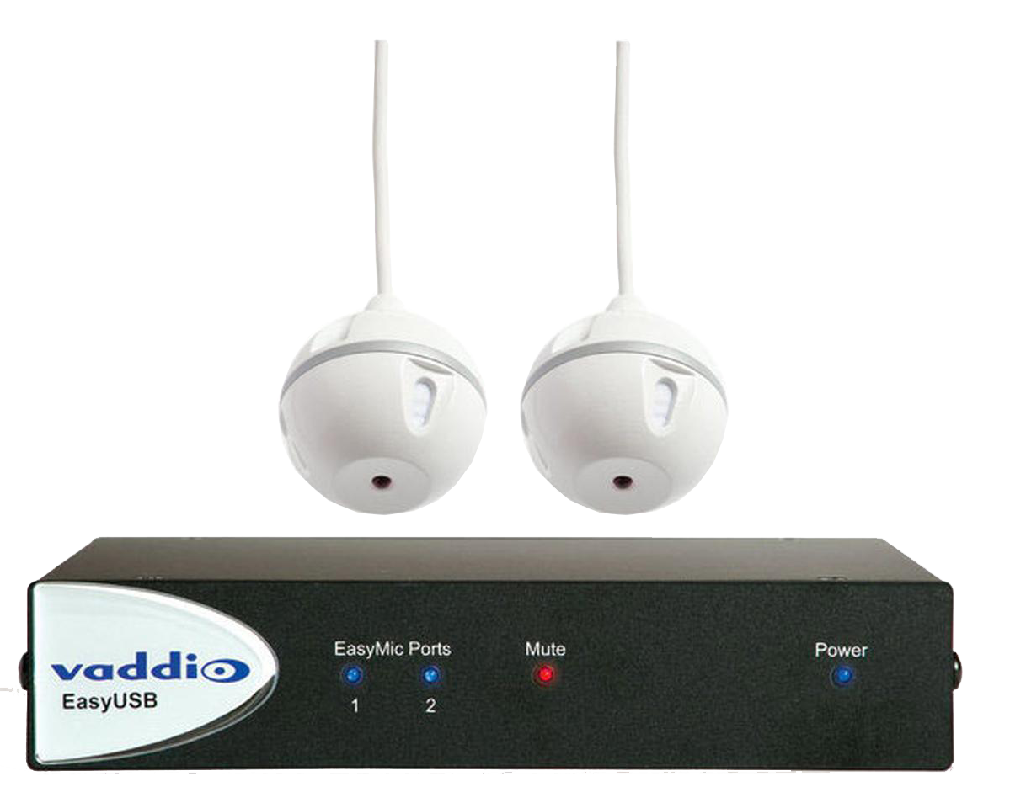
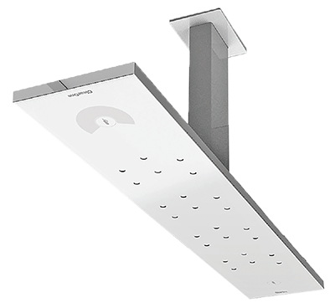
Hardware Solutions we explored
Microphones
  Vaddio EasyTALK
    Standard UAC Driver
    ClearOne Beamforming Microphone Array

Slide 18
Ongoing Support
Supportable, Sustainable and Scaleable
  Three Options Supported
    FUZE
    SKYPE
    Polycom

Slide 19
Future Development
Potential for dedicated FUZE rooms
  We “almost” have one
Potential for more high tech options in our Lecture Capture rooms
  We hope to build two this year

Slide 20

Thanks
Questions?
    Fermin Romero III
    Assistant Director Technology Services
    Phone: (607) 778-5657
    Email: romerof@sunybroome.edu

